Slide 1
Functions
Programming for Data Analysis (CT127-3-2-PFDA and Version VC1)

Slide 2
Topic & Structure of the lesson
- Writing functions.
How to call a function.
Named arguments.
Default values for arguments.
Return value from functions.

Slide 3
Learning outcomes
At the end of this topic, you should be able to:
Understand how to write a function and calling it.
How to pass arguments and return values in a function.

Slide 4
Key terms you must be able to use
If you have mastered this topic, you should be able to use the following terms correctly in your assignments and exams:
- function
- argument
- return value

Slide 5
1
Functions?

Slide 6
Functions
A function is a piece of code written to carry out a specified task.
Functions are used to logically break our code into simpler parts which become easy to maintain and understand.
It’s a pretty straightforward to create your own function in R programming.

Slide 7
Functions
Human Resource Department
function
CalculateGrossSalary
inMoney<- weeks*hoursPerWeek*hourlyRate + bonuse
outMoney<- inMoney - inMoney*tax
……
inMoney<- weeks*hoursPerWeek*hourlyRate + bonuse
outMoney<- inMoney - inMoney*tax
….
Human Resource Department
……
CalculateGrossSalary
….
Accounting Department
….
inMoney<- weeks*hoursPerWeek*hourlyRate + bonuse
outMoney<- inMoney - inMoney*tax
….
Accounting Department
….
CalculateGrossSalary
….
Audit Department
Audit Department
….
inMoney<- weeks*hoursPerWeek*hourlyRate + bonuse
outMoney<- inMoney - inMoney*tax
….
….
CalculateGrossSalary
….

Slide 8
2
Writing Functions

Slide 9
Functions
Syntax for Writing Functions in R
func_name <- function (arguments) {
// statements
}
Here we can see that the reserved word function is used to declare a function in R.
The statements within the curly braces form the body of the function.
func_name is a name assigned to a function.
It can or can not accept arguments and it can or can not return one or more values.

Slide 10
Functions
func_name <- function (arguments) {
// statements
}
Example:
hellofunction <- function()
{
print("Hello, World!")
}

Slide 11
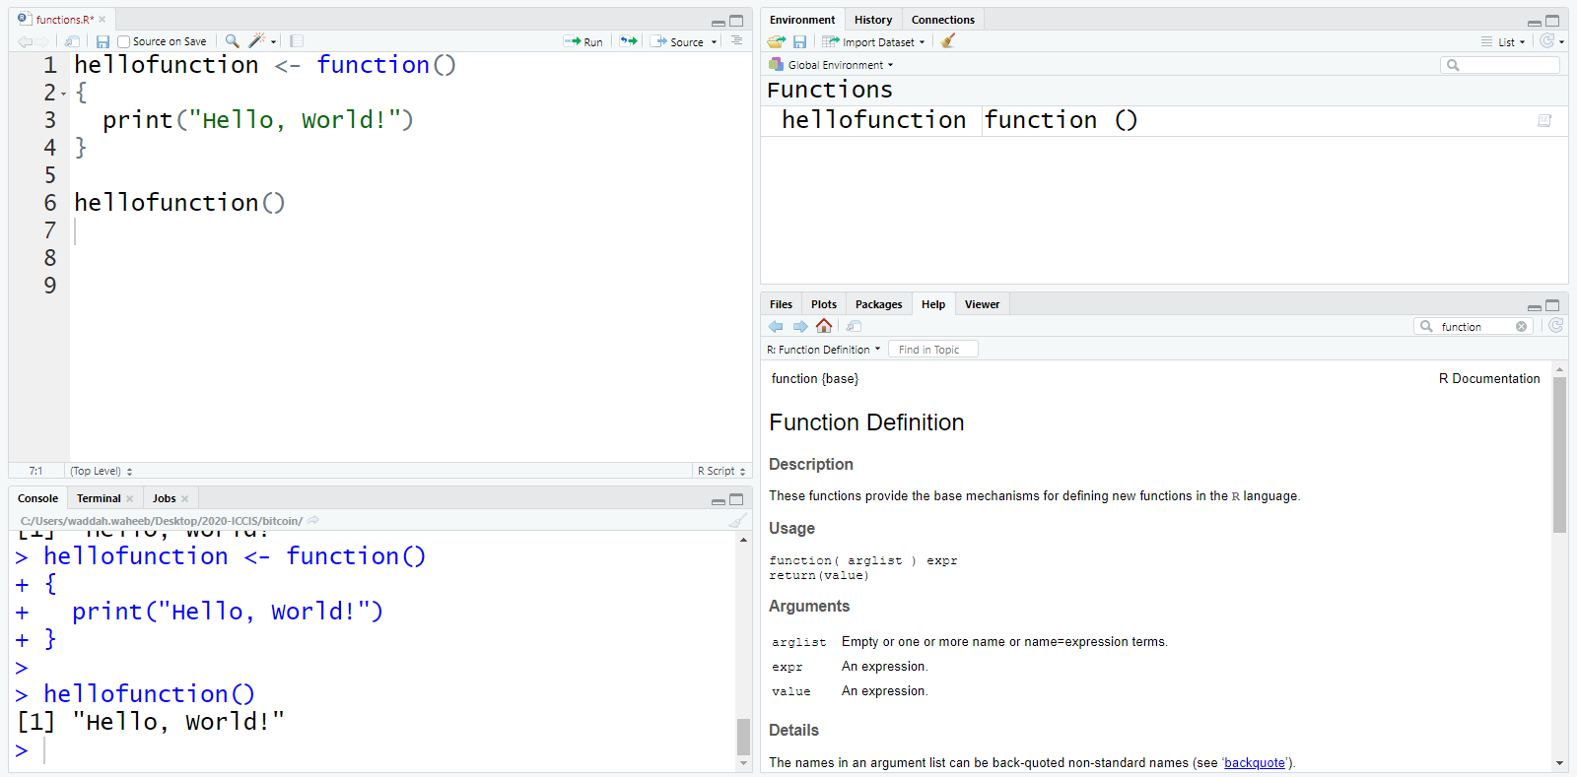
Functions – Example 1

Slide 12
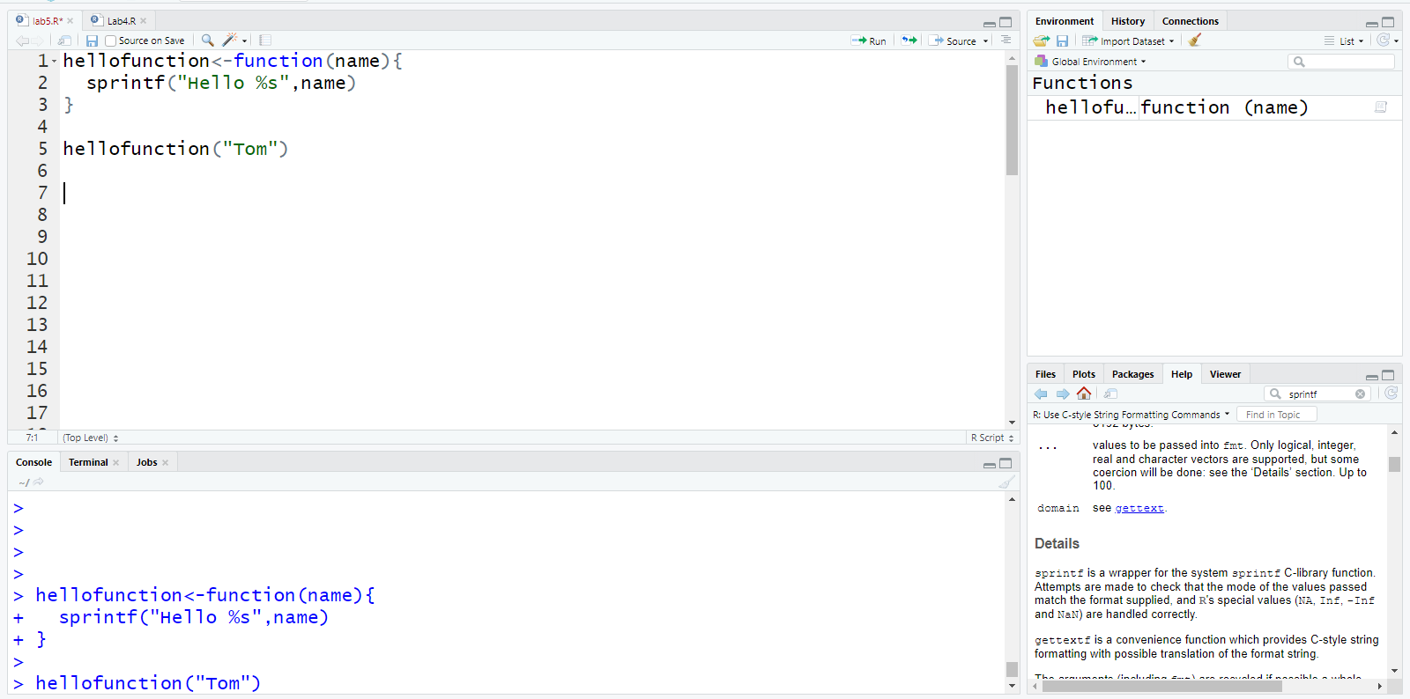
Functions – Example 2

Slide 13
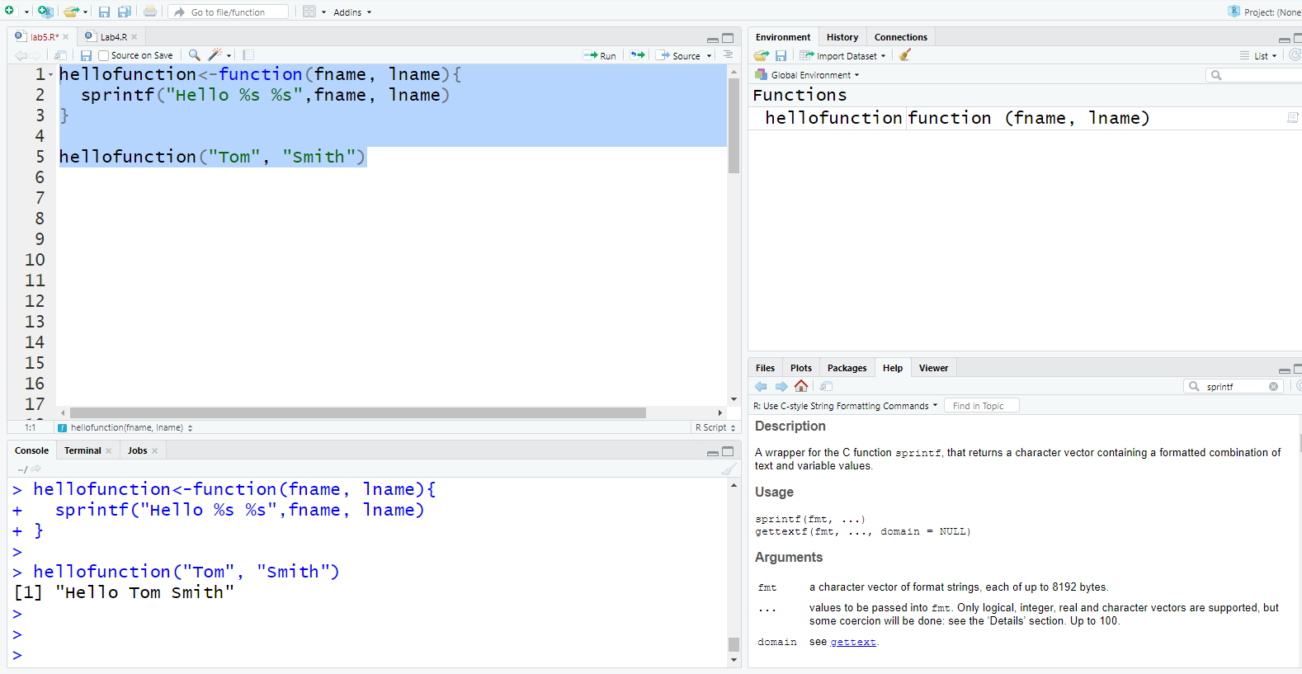
Functions – Example 3

Slide 14
3
Default Values for Arguments

Slide 15
Default Values for Arguments
We can assign default values to arguments in a function in R.
This is done by providing an appropriate value to the argument in the function declaration.
pow <- function(x, y = 2) {
# function to print x raised to the power y
res <- x^y
print(paste(x,“ raised to the power ", y, “ is ",res))
}
The function pow() takes two arguments to calculate the first argument raised to the power of the second argument. Then, it prints the result in appropriate format.
y is optional. The value 2 is assigned when y is not provided.

Slide 16
Default Values for Arguments
pow <- function(x, y = 2) {
# function to print x raised to the power y
res <- x^y
print(paste(x,“ raised to the power ", y, “ is ",res))
}
> pow(3)
[1] "3 raised to the power 2 is 9"
> pow(3,1)
[1] "3 raised to the power 1 is 3“

Slide 17
4
How to Return a Value?

Slide 18
R Return Value from Function
Functions are generally used for computing some values, so they need a mechanism to supply that value back to the caller. This is called returning.
The value of the last line of the code in a function is automatically returned.
The return command specifies that a value should be returned and the function should be exited.
The syntax of return is:
return(expression)

Slide 19
5
More Examples

Slide 20
Functions – Example 4
Use the concept of functions to reproduce the following code which checks whether a number is even or odd.
check <- function(x) {
if (x %% 2 == 0) {
result <- “Even"
}else {
result <- “Odd"
}
return(result)
}
x=8
if (x %% 2 == 0) {
result <- “Even"
}else {
result <- “Odd"
}
> check(8)
[1] “Even"
> check(9)
[1] “Odd"

Slide 21
Functions – Example 5
Assume there is a vector called “emp” with the following data 140 253 137 358 279. This vector contains employees' IDs.
Based on the first digit from the left for each employee ID, the output should be as follow: if it is 1 print employee ID in red color, if it is 2 print employee ID in green color, if it is 3 print it in blue color.

Slide 22
Functions – Example 5
Loop based on the count of employees.
Get the first digit from the left for each line.
deptID = i %/% 100 (345 %/% 100 =3)
If this digit is 1 print employee number in red color, if it is 2 print employee number in green color, if it is 3 print employee number in blue color.
library(crayon)
red(i), green(i), blue(i)

Slide 23
Functions – Example 5
library(crayon)
IDs= c(140,253,137,358,279)
my_print(IDs){
for(i in IDs)
{
deptID = i %/% 100
if (deptID==1)
{message(red(i))}
else if (deptID==2) {message(green(i))}
else {message(blue(i))}
}
}
140
253
137
358
279

Slide 24
Functions – Example 5
library(crayon)
IDs= c(140,253,137,358,279)
IDs=sort(IDS)
my_print<-function(IDs){
for(i in IDs)
{
deptID = i %/% 100
if (deptID==1)
{message(red(i))}
else if (deptID==2) {message(green(i))}
else {message(blue(i))}
}
}
140
253
137
358
279
137
140
253
279
358

Slide 25
Quick Review

Slide 26
Quick Review Questions
How to create a function in R?
How to pass parameters in R?
What is the purpose of return value in a function?

Slide 27
Summary of Main Teaching Points
- Writing functions.
How to call a function.
Named arguments.
Default values for arguments.
Return value from functions.
Learning outcomes:
You should be able to:
Write a function and call it.
Pass arguments and return values in a function.

Slide 28
Question and Answer Session
Q & A
Book consultation slots for assistance.

Slide 29
Next Session
Data Import
Access data included with R
Read data into a vector or list
Read CSV files
Read large data files
Read Excel files
Read from Databases

